Slide 1
实用操作系统概念
张惠娟 王冬青
Ms.zhj@163.com
Wang.box@163.com

Slide 2
内容框架
概述
体系结构
进程管理
内存管理
文件管理
外设管理

Slide 3
内容
Ch4: 进程
Ch5: 线程
Ch6: CPU调度
Ch7：进程同步
Ch8：死锁

Slide 4
Ch 6: CPU Scheduling
Basic Concepts
Scheduling Criteria
Scheduling Algorithms
Multiple-Processor Scheduling
Real-Time Scheduling
Thread Scheduling
Algorithm Evaluation

Slide 5
Ch 6: CPU Scheduling
Basic Concepts
Scheduling Criteria
Scheduling Algorithms
Multiple-Processor Scheduling
Real-Time Scheduling
Thread Scheduling
Algorithm Evaluation

Slide 6
Basic Concepts
CPU和I/O
CPU Scheduler
Dispatcher

Slide 7
Basic Concepts
CPU和I/O
CPU Scheduler
Dispatcher

Slide 8
Basic Concepts
CPU和I/O
  Maximum CPU utilization obtained with multiprogramming
  CPU–I/O Burst Cycle
  Process execution consists of a cycle of CPU execution and I/O wait.

Slide 9

Alternating Sequence of CPU And I/O Bursts

Slide 10

I/O约束程序具有很多短CPU区间
CPU约束程序具有少量长CPU区间
CPU区间分布图

Slide 11
Basic Concepts
CPU和I/O
CPU Scheduler
Dispatcher

Slide 12
Basic Concepts
CPU Scheduler(调度器)
  CPU scheduler selects a process from the ready processes and allocates the CPU to it.

Slide 13
Basic Concepts
CPU scheduling decisions may take place when a process:
    Terminates.
    Switches from running to waiting state.
    Switches from running to ready state.
    Switches from waiting to ready.
Scheduling under 1 and 2 only is non-preemptive(非抢占).
  Win 3.x，Apple Macintosh
Scheduling under all conditions is preemptive(抢占).
  Win 9x, Win NT/2K/XP, Linux

Slide 14
Basic Concepts
CPU和I/O
CPU Scheduler
Dispatcher

Slide 15
Basic Concepts
Dispatcher（派遣器）
  Dispatcher module gives control of the CPU to the process selected by the short-term scheduler; this involves:
    switching context (saving context and restoring context)
    switching to user mode (monitor mode → user mode)
    jumping to the proper location in the user program to restart that program(PC counter)
  Dispatch latency(分派延时) – time it takes for the dispatcher to stop one process and start another running.

Slide 16
Ch 6: CPU Scheduling
Basic Concepts
Scheduling Criteria
Scheduling Algorithms
Multiple-Processor Scheduling
Real-Time Scheduling
Thread Scheduling
Algorithm Evaluation

Slide 17
Scheduling Criteria
General Criteria
Optimization Criteria

Slide 18
Scheduling Criteria
General Criteria
  CPU utilization（使用率）
  keep the CPU as busy as possible
  Throughput（吞吐量）
  number of processes that complete their execution per time unit
  Turnaround time（周转时间）
  amount of time to execute a particular process
  从等待进入内存到进程结束
系统角度
用户角度

Slide 19
Scheduling Criteria
  Waiting time（等待时间）
  amount of time a process has been waiting in the ready queue （就绪队列中等待时间总和）
  Response time （响应时间）
  amount of time it takes from when a request was submitted until the first response is produced, not output (for time-sharing environment)

Slide 20
Scheduling Criteria
Optimization Criteria
  Max CPU utilization
  Max throughput
  Min turnaround time
  Min waiting time
  Min response time
本书标准：最小化平均等待时间

Slide 21
Ch 6: CPU Scheduling
Basic Concepts
Scheduling Criteria
Scheduling Algorithms
Multiple-Processor Scheduling
Real-Time Scheduling
Thread Scheduling
Algorithm Evaluation

Slide 22
Scheduling Algorithms
  FCFS (First-Come, First-Served ) （先到先行调度）
  SJF (Shortest-Job-First )（最短作业优先调度）
  Priority Scheduling（优先级调度）
  RR (Round Robin ) （轮转法调度）
  Multilevel Queue（多级队列调度）

Slide 23
Scheduling Algorithms
  FCFS (First-Come, First-Served ) （先到先行调度）
  SJF (Shortest-Job-First )（最短作业优先调度）
  Priority Scheduling（优先级调度）
  RR (Round Robin ) （轮转法调度）
  Multilevel Queue（多级队列调度）

Slide 24
FCFS Scheduling
Example
  Process Burst Time( 区间时间ms)
  P₁ 24
  P₂ 3
  P₃ 3

Slide 25
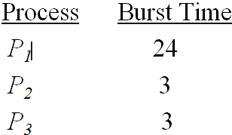
FCFS Scheduling
Suppose that the processes arrive in the order: P₁ ,P₂ , P₃ The Gantt Chart for the schedule is:
P₁
P₂
P₃
0
24
27
30
  Waiting time for P₁ = 0; P₂ = 24; P₃ = 27
  Average waiting time: (0 + 24 + 27)/3 = 17

Slide 26
FCFS Scheduling
Suppose that the processes arrive in the order
P₂ , P₃ , P₁ .The Gantt chart for the schedule is:
P₂
P₃
P₁
0
3
6
30
  Waiting time for P1 = 6; P2 = 0; P3 = 3
  Average waiting time: (6 + 0 + 3)/3 = 3
  Much better than previous case.

Slide 27
FCFS Scheduling
Convoy effect (护航效果) : short process behind long process and waiting for a long time.
The FCFS scheduling algorithm is nonpreemptive.
The FCFS algorithm is particularly troublesome for time-sharing systems.
  It would be disastrous to allow one process to keep the CPU for an extended period.

Slide 28
Scheduling Algorithms
  FCFS (First-Come, First-Served ) （先到先行调度）
  SJF (Shortest-Job-First )（最短作业优先调度）
  Priority Scheduling（优先级调度）
  RR (Round Robin ) （轮转法调度）
  Multilevel Queue（多级队列调度）

Slide 29
SJF Scheduling
Definition
Schemes
Example

Slide 30
SJF Scheduling
Definition
Schemes
Example

Slide 31
SJF Scheduling
Definition
  Associate with each process the length of its next CPU burst. Use these lengths to schedule the process with the shortest time.
  SJF is optimal – gives minimum average waiting time for a given set of processes

Slide 32
SJF Scheduling
Definition
Schemes
Example

Slide 33
SJF Scheduling
Two schemes:
  Ｎonpreemptive
  once CPU given to the process it cannot be preempted until completes its CPU burst.
  Preemptive
  if a new process arrives with CPU burst length less than remaining time of current executing process, preempt. This scheme is know as the
  Shortest-Remaining-Time-First (SRTF最短剩余时间优先).

Slide 34
SJF Scheduling
Definition
Schemes
Example

Slide 35
SJF Scheduling
Example of Non-Preemptive SJF
Process Arrival Time Burst Time
P₁ 0.0 7
P₂ 2.0 4
P₃ 4.0 1
P₄ 5.0 4

Slide 36
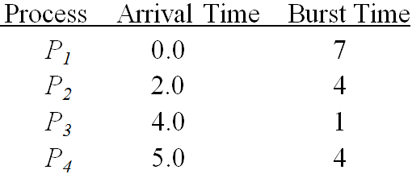
SJF Scheduling
The Gantt chart for the schedule is
P₁
P₃
P₂
P₄
0
3
7
8
12
16
Average waiting time
= (0 + 6 + 3 + 7)/4 = 4

Slide 37
SJF Scheduling
Example of Preemptive SJF
Process Arrival Time Burst Time
P₁ 0.0 7
P₂ 2.0 4
P₃ 4.0 1
P₄ 5.0 4

Slide 38
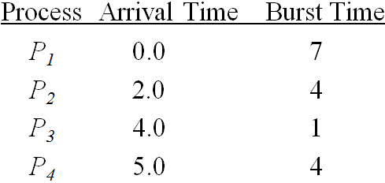
SJF Scheduling
  The Gantt chart for the schedule is
  Average waiting time
  = (9 + 1 + 0 +2)/4 = 3
P₁
P₂
P₃
P₂
P₄
P₁
0
2
4
5
7
11
16

Slide 39
SJF Scheduling
  The SJF scheduling algorithm is provably optimal.
  The SJF scheduling algorithm supports both preemptive and non-preemptive scheduling algorithms.
  Suitable for long-term scheduling(作业调度).
  Not very good for short-term scheduling(CPU调度).
  Difficult to estimate the CPU bursts.

Slide 40
Scheduling Algorithms
  FCFS (First-Come, First-Served ) （先到先行调度）
  SJF (Shortest-Job-First )（最短作业优先调度）
  Priority Scheduling（优先级调度）
  RR (Round Robin ) （轮转法调度）
  Multilevel Queue（多级队列调度）

Slide 41
Priority Scheduling
A priority number (integer) is associated with each process
The CPU is allocated to the process with the highest priority (smallest integer ≡ highest priority).
  Preemptive
  nonpreemptive

Slide 42
Priority Scheduling
SJF is a priority scheduling where priority is the predicted next CPU burst time.
Problem：Starvation(饥饿) – low priority processes may never execute.
Solution：Aging(老化) – A process will increase its priority with time.

Slide 43
Priority Scheduling
Process Burst Time Priority
P1 10 3
P2 1 1
P3 2 4
P4 1 5
P5 5 2

Slide 44
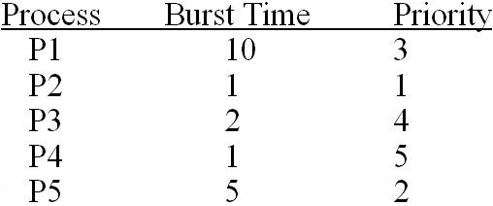

Priority Scheduling
  Priority scheduling
  Waiting time: (6+0+16+18+1)/5 =8.2.

Slide 45
Scheduling Algorithms
  FCFS (First-Come, First-Served ) （先到先行调度）
  SJF (Shortest-Job-First )（最短作业优先调度）
  Priority Scheduling（优先级调度）
  RR (Round Robin ) （轮转法调度）
  Multilevel Queue（多级队列调度）

Slide 46
Round Robin (RR)
Definition
Performance
Example

Slide 47
Round Robin (RR)
Definition
Performance
Example

Slide 48
Round Robin (RR)
Definition
  Each process gets a small unit of CPU time (time quantum), usually 10-100 milliseconds. After this time has elapsed, the process is preempted and added to the end of the ready queue.
  If there are n processes in the ready queue and the time quantum is q, then each process gets 1/n of the CPU time in chunks of at most q time units at once.
  No process waits more than (n-1)q time units.

Slide 49
Round Robin (RR)
Definition
Performance
Example

Slide 50
Round Robin (RR)
Performance
  q large ⇒ FIFO
  q small ⇒ q must be large with respect to context switch, otherwise overhead is too high.

Slide 51
Round Robin (RR)
Definition
Performance
Example

Slide 52
Round Robin (RR)
Example
Process Burst Time
P₁ 53
P₂ 17
P₃ 68
P₄ 24

Slide 53
Round Robin (RR)
The Gantt chart is:
Quantum = 20
平均等待时间＝？
Typically, higher average turnaround than SJF, but better response.
P₁
P₂
P₃
P₄
P₁
P₃
P₄
P₁
P₃
P₃
0
20
37
57
77
97
117
121
134
154
162

Slide 54
Scheduling Algorithms
  FCFS (First-Come, First-Served ) （先到先行调度）
  SJF (Shortest-Job-First )（最短作业优先调度）
  Priority Scheduling（优先级调度）
  RR (Round Robin ) （轮转法调度）
  Multilevel Queue（多级队列调度）

Slide 55
Multilevel Queue
Definition
Multilevel Queue Scheduling
Multilevel Feedback Queue

Slide 56
Multilevel Queue
Definition
Multilevel Queue Scheduling
Multilevel Feedback Queue

Slide 57
Multilevel Queue
Definition
  Ready queue is partitioned into separate queues:
    foreground (interactive)--前台（交互式）
    background (batch) )—后台（批处理）
  Each queue has its own scheduling algorithm,
    foreground – i.e.RR
    background – i.e.FCFS

Slide 58
Multilevel Queue
Definition
Multilevel Queue Scheduling
Multilevel Feedback Queue

Slide 59
Multilevel Queue
Scheduling must be done between the queues.
  Fixed priority scheduling; i.e., serve all from foreground then from background. Possibility of starvation.
  Time slice – each queue gets a certain amount of CPU time which it can schedule amongst its processes; i.e.,80% to foreground in RR,20% to background in FCFS

Slide 60

Multilevel Queue Scheduling

Slide 61
Multilevel Queue
Definition
Multilevel Queue Scheduling
Multilevel Feedback Queue

Slide 62
Multilevel Feedback Queue
A process can move between the various queues; aging can be implemented this way.
Multilevel-feedback-queue scheduler defined by the following parameters:
  number of queues.
  scheduling algorithms for each queue.
  method used to determine which queue a process will enter when that process needs service.
  method used to determine when to upgrade/downgrade a process.

Slide 63
Multilevel Feedback Queue
Three queues:
  Q0 – time quantum 8 milliseconds
  Q1 – time quantum 16 milliseconds
  Q2 – FCFS
Scheduling
  A new job enters queue Q0 which is served FCFS. When it gains CPU, job receives 8 milliseconds. If it does not finish in 8 milliseconds, job is moved to queue Q1.
  At Q1, job is again served FCFS and receives 16 additional milliseconds. If it still does not complete, it is preempted and moved to queue Q2.

Slide 64

Multilevel Feedback Queues

Slide 65
Ch 6: CPU Scheduling
Basic Concepts
Scheduling Criteria
Scheduling Algorithms
Multiple-Processor Scheduling
Real-Time Scheduling
Thread Scheduling
Algorithm Evaluation

Slide 66
Multiple-Processor Scheduling
CPU scheduling more complex when multiple
CPUs are available.
Homogeneous processors within a
multiprocessor.
  Symmetric Multiprocessing (SMP) – each processor makes its own scheduling decisions.
  Asymmetric multiprocessing – only one processor accesses the system data structures, alleviating the need for data sharing.
！
哪个难实现？

Slide 67
Ch 6: CPU Scheduling
Basic Concepts
Scheduling Criteria
Scheduling Algorithms
Multiple-Processor Scheduling
Real-Time Scheduling
Thread Scheduling
Algorithm Evaluation

Slide 68
Real-Time Scheduling
  Hard real-time systems --required to complete a critical task within a guaranteed amount of time.
  Hard real-time systems are composed of special-purpose software running on hardware dedicated to their critical process, and lack the full functionality of modern computers and operating systems.
Soft real-time computing --requires that critical processes receive priority over less fortunate ones.
  Priority scheduling
  Low dispatch latency（降低分派延迟）
    To insert preemption points(抢占点).
    To make the entire kernel preemptible.
    To support priority inversion(优先级倒置)：用优先级继承解决

Slide 69
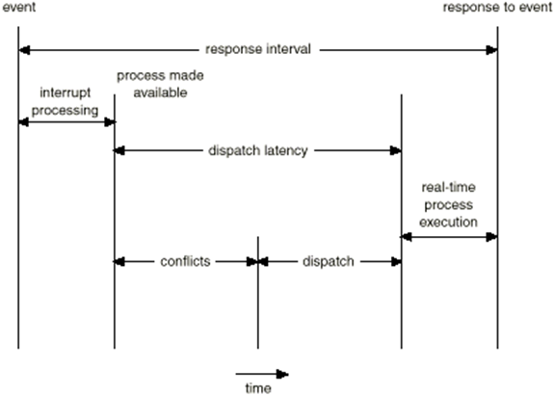
Real-Time Scheduling
分派延迟
第二阶段：分配进程需要资源
第一阶段：抢占运行进程
分派延迟组成

Slide 70
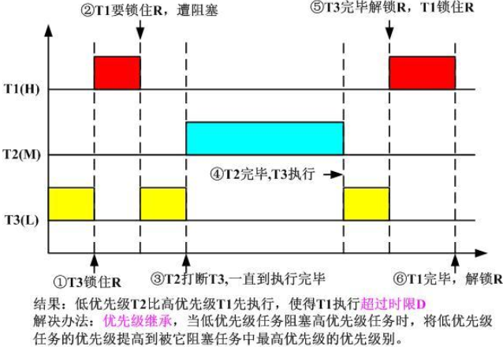
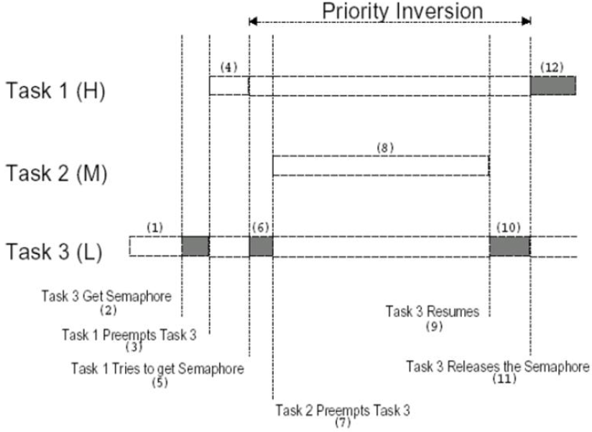
Real-Time Scheduling

Slide 71
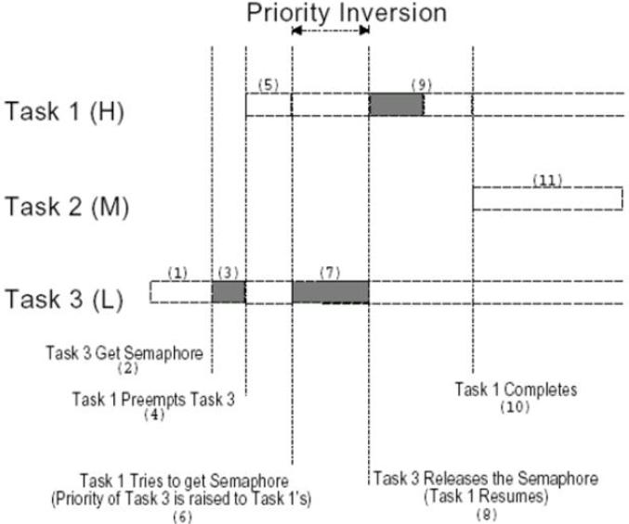
Real-Time Scheduling
优先级继承后

Slide 72
Ch 6: CPU Scheduling
Basic Concepts
Scheduling Criteria
Scheduling Algorithms
Multiple-Processor Scheduling
Real-Time Scheduling
Thread Scheduling
Algorithm Evaluation

Slide 73
Thread Scheduling
Scheduling methods
Solaris 2 Scheduling
Java Thread Scheduling

Slide 74
Thread Scheduling
Scheduling methods
  Process Local Scheduling
  How the threads library decides which thread to put onto an available LWP.
  Global Scheduling
  How the kernel decides which kernel thread to run next.

Slide 75
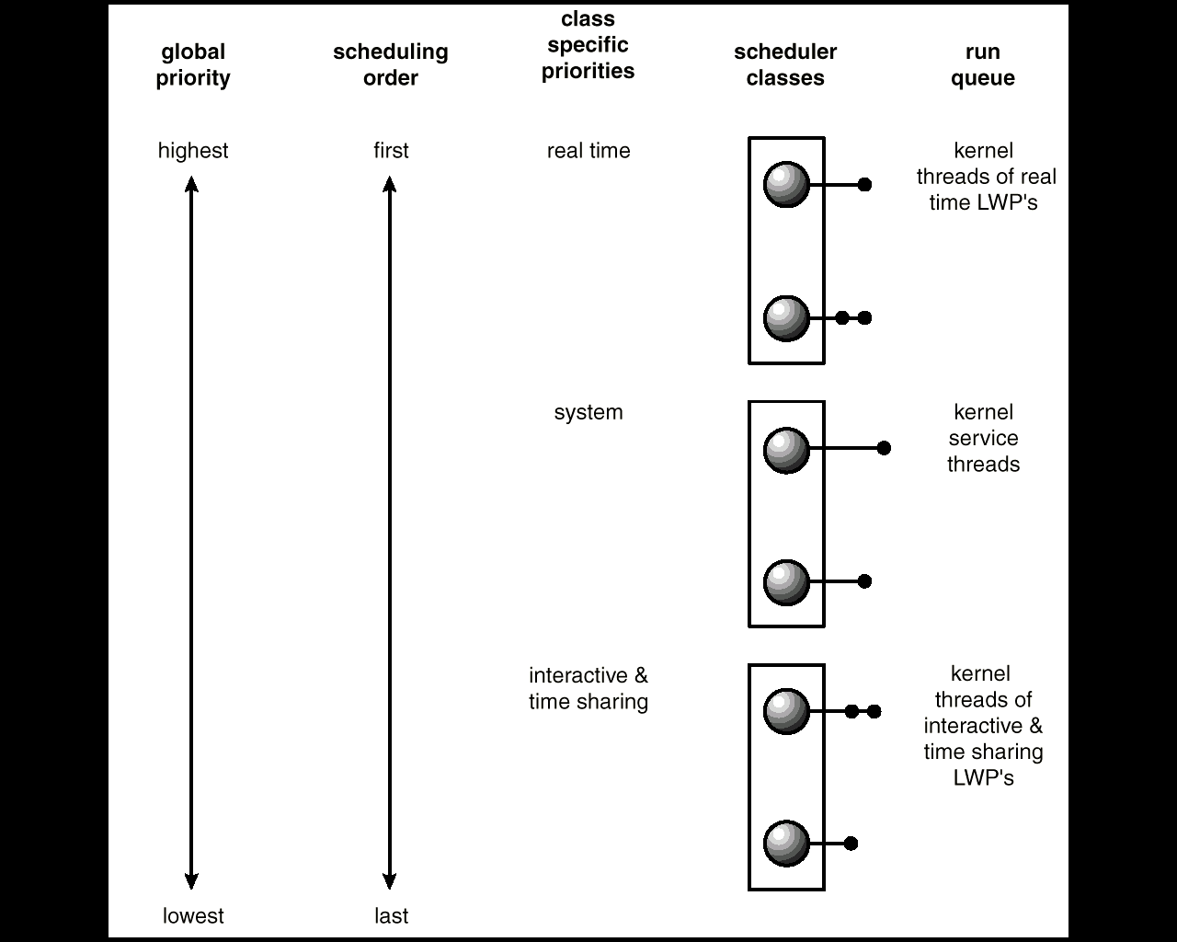
Solaris 2 Scheduling

Slide 76
Java Thread Scheduling
JVM Uses a Preemptive, Priority-Based Scheduling Algorithm.
FIFO Queue is Used if There Are Multiple Threads With the Same Priority.
JVM Schedules a Thread to Run When:
  The Currently Running Thread Exits the Runnable State.
  A Higher Priority Thread Enters the Runnable State

Slide 77
Ch 6: CPU Scheduling
Basic Concepts
Scheduling Criteria
Scheduling Algorithms
Multiple-Processor Scheduling
Real-Time Scheduling
Thread Scheduling
Algorithm Evaluation

Slide 78
Algorithm Evaluation
    Deterministic modeling（确定性建模）
    Queueing models（排队模型）
    Simulations（模拟）
    Implementation （实现）

Slide 79
Algorithm Evaluation
    Deterministic modeling（确定性建模）
    Queueing models（排队模型）
    Simulations（模拟）
    Implementation （实现）

Slide 80
Analytic Evaluation:
Deterministic modeling
Deterministic modeling(确定性建模)
takes a particular predetermined workload and defines the performance of each algorithm for that workload.
  To describe scheduling algorithms and provide examples
  Simple and fast
  But, Too specific to be useful.
假设特例---以点概面

Slide 81
Algorithm Evaluation
    Deterministic modeling（确定性建模）
    Queueing models（排队模型）
    Simulations（模拟）
    Implementation （实现）

Slide 82
Queuing models
Queuing models（排队模型）
  Queueing-network analysis
  The computer system is described as a network of servers.
  Each server has a queue of waiting process.
  Knowing arrival rates and service rates, we can compute utilization, average queue length, average wait time, and so on.
Useful for comparing scheduling algorithms.
Real distributions are difficult to work with.
Some assumptions required.
利用统计学原理，求平均

Slide 83
Algorithm Evaluation
    Deterministic modeling（确定性建模）
    Queueing models（排队模型）
    Simulations（模拟）
    Implementation （实现）

Slide 84
Simulations
Simulations (模拟) involve programming a model of the computer system.
  Software data structures represent the major components of the system.
  The simulator has a variable representing a clock; as this variable ‘s value is increased, the simulator modifies the system to reflect the activities of the device, the processes, and the scheduler.
  As the simulation executes, statistics that indicate algorithm performance are gathered and printed.
Artificial data or trace tapes.
Useful but expensive.

Slide 85

Evaluation of CPU Schedulers by Simulation
需要大量存储空间
大量设计、编码、调试工作

Slide 86
Algorithm Evaluation
    Deterministic modeling（确定性建模）
    Queueing models（排队模型）
    Simulations（模拟）
    Implementation （实现）

Slide 87
Implementation
Implementation (实现)
  To code the algorithm,
  To put it in the OS, and
  To see how it works.
Costly.
A Perfect Scheduling Algorithm Is Not Easy To Found.

Slide 88
小结
调度概念
几种CPU调度算法

Slide 89
Exercises
阅读p114-p139
P140
6.2~6.6

